Slide 1

Regression Analysis of Car Dataset
By: Christian, O’Neal and Mohammad
Date: June 5th, 2023
Notes:
Hello, welcome to 6372 Consulting's presentation! I am Mohammad Al-Rousan and I am welcomed alongside Christian Orji and O'Neal Gray

Slide 2

Overview
Our analysis aimed to explore and understand the factors influencing the Manufacturer’s Suggested Retail Price (MSRP) of various car models (from the Kaggle Car Data Set), as detailed in our data set.
Our goals were;
Build a Regression Model: We wanted to build a linear regression model to identify the relationship between the various features of a car and its MSRP. Our initial model served as a baseline for understanding the key factors contributing to the price of a car.
To develop a more complex model to produce better predictions: We wanted to improve on our initial model by adding complexity, such as interaction terms and polynomial features, and by trying different, more flexible machine learning techniques. In particular, we employed a Gradient Boosting Model to enhance our analysis’s predictive power.
Models Used in our project;
Linear Regression
Polynomial Regression
Gradient Boosting Model
Notes:
In our project, we aimed to analyze the factors influencing the Manufacturer's Suggested Retail Price (MSRP) of car models using the Kaggle Car Data Set. Our goals were to build a baseline linear regression model to understand the key factors affecting car prices and then enhance our predictions by incorporating complexity through techniques like polynomial regression and employing a Gradient Boosting Model for improved predictive power. The models used in our project include Linear Regression, Polynomial Regression, and Gradient Boosting Model.

Slide 3
Data Description - The car dataset contains detailed specifications and characteristics for a range of 11,914 different car models. It includes the following 16 variables:
Make: The manufacturer of the car model (e.g., Ford, Toyota, BMW). It's a categorical variable.
Model: The specific model of the car as produced by the manufacturer. It's a categorical variable.
Year: The year the car model was manufactured. It's a numerical variable, ranging from 1990 to 2017.
Engine Fuel Type: The type of fuel the car's engine uses. It's a categorical variable.
Engine HP: The horsepower of the car's engine. It's a numerical variable, with a minimum value of 55 and a maximum of 1001. There are 69 missing values in this column.
Engine Cylinders: The number of cylinders in the car's engine. It's a numerical variable, ranging from 0 to 16. There are 30 missing values in this column.
Transmission Type: The type of transmission in the car (e.g., manual, automatic). It's a categorical variable.
Driven Wheels: Describes which wheels are driven by the engine (e.g., front, rear, all). It's a categorical variable.
Number of Doors: The number of doors in the car. It's a numerical variable, ranging from 2 to 4. There are 6 missing values in this column.
Market Category: The market segment the car is targeted at. It's a categorical variable.
Vehicle Size: The size category of the vehicle (e.g., compact, midsize, large). It's a categorical variable.
Vehicle Style: The style of the vehicle (e.g., sedan, coupe, SUV). It's a categorical variable.
Highway MPG: The car's fuel efficiency on the highway, measured in miles per gallon (MPG). It's a numerical variable, ranging from 12 to 354 MPG.
City MPG: The car's fuel efficiency in the city, measured in MPG. It's a numerical variable, ranging from 7 to 137 MPG.
Popularity: The popularity of the car, measured in a way not specified in the provided summary. It's a numerical variable, with a minimum value of 2 and a maximum of 5657.
MSRP: The Manufacturer's Suggested Retail Price of the car, which is its listed price before any discounts or negotiations. It's a numerical variable, ranging from $2000 to $2,065,902.
Overall, this dataset provides a comprehensive overview of the characteristics and specifications of a wide range of car models, and would be useful for many types of analysis, such as understanding trends in car manufacturing, predicting car prices, or analyzing fuel efficiency.

Slide 4
Data Cleaning and observations
In this analysis, thorough data cleaning and verification were conducted before proceeding with the examination of various variables and their potential relationship with the price (MSRP) of cars. Missing data was addressed by inserting 0 values for electric cars and updating a small number of missing horsepower data points manually. The overall effect on the summary statistics was minimal. The distribution of the MSRP variable was initially non-normal but greatly benefited from a log transformation. Correlation charts and plots revealed interesting relationships, with horsepower, vehicle style, and engine cylinders showing significant correlations with MSRP. No outliers were removed based on Cook's D, and the data was evenly split into training, testing, and validation datasets.
Notes:
Thorough data cleaning and verification were conducted to ensure the integrity of the dataset. The missing data, which accounted for 99 entries, primarily resulted from electric cars being measured differently from traditional gasoline vehicles. To address this, we inserted 0 values for the "Number of Cylinders" and "HP" variables for all electric cars, considering them as distinct factors for analysis. This approach ensured that the absence of data for electric cars did not have any adverse effects on the overall analysis.
In addition to the missing data for electric cars, we also noticed a few instances of missing HP data for specific car models, namely Mazda, Ford, and Lincoln. To rectify this, we manually updated the missing data points by gathering information from reliable sources available online. Since the number of missing records was small, the impact on the summary statistics was minimal, with less than a 1% difference observed.
To maintain consistency, all horsepower data was sourced from Motor Trend. This ensured that the dataset was reliable and standardized in terms of the horsepower variable.

Slide 5
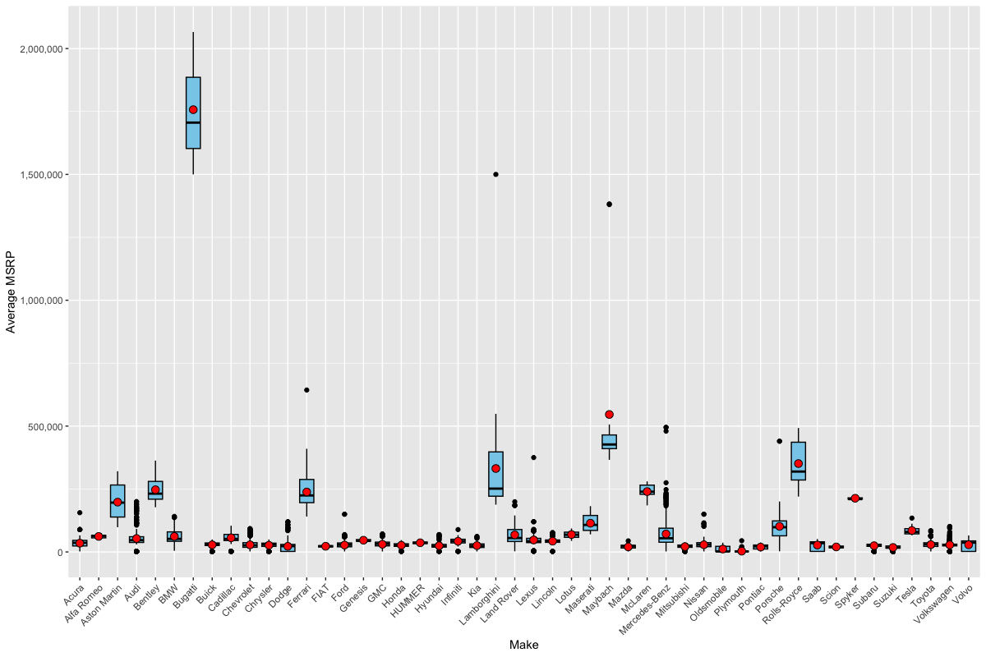
EDA – Average MSRP VS. Make
Notes:
After first observations of the MSRP v. the Make, we can clearly see there is an outlier between the Bugatti and the rest of the makes. Outliers are important as they can reveal data quality issues and provide insights into the distribution and summary statistics of the data, helping us understand potential anomalies and make informed decisions about data preprocessing and modeling approaches and we employed such as data cleansing techniques.

Slide 6
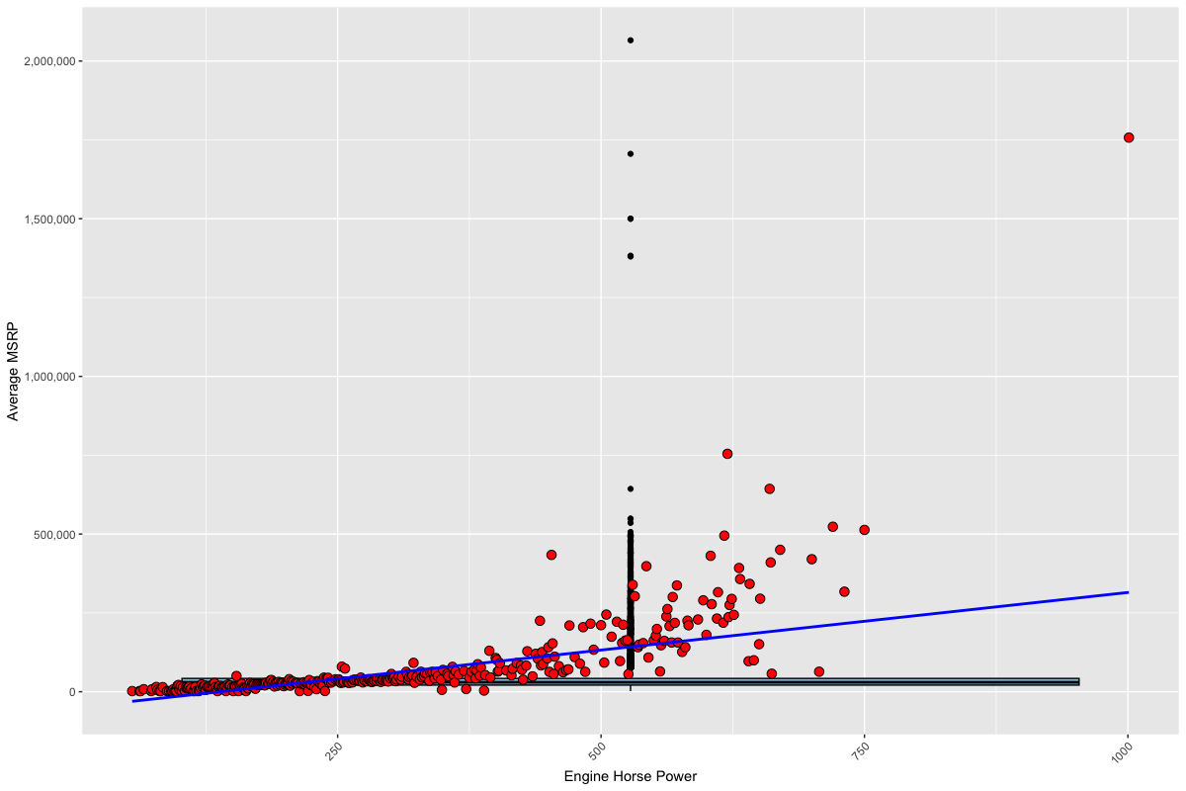
EDA – Average MSRP Vs. Engine HP
Notes:
As we increase the HP, MSRP increases, although we have some outliers.

Slide 7
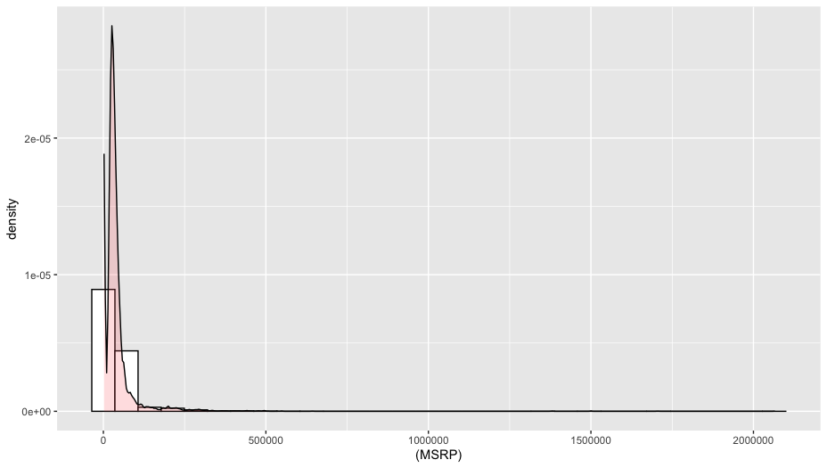
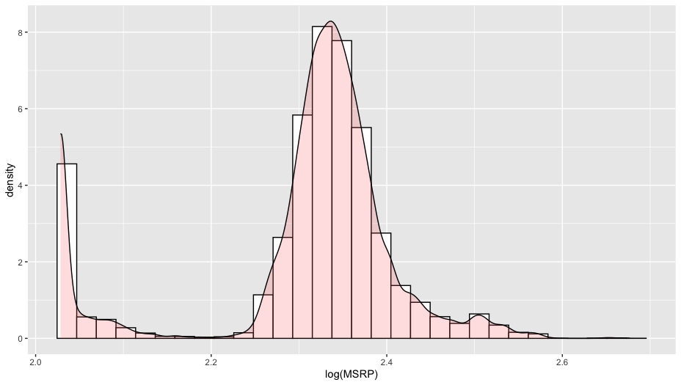
EDA – Histogram of LOG MSRP
Before Log Transformation
After Log Transformation
Notes:
Here we have the MSRP as the x-axis and the y axis displays the density of the data. The first chart to the left is before log transformation and shows the density skewed to the left. The chart to the right shows after the log transformation and the density is more of a normal distribution.

Slide 8
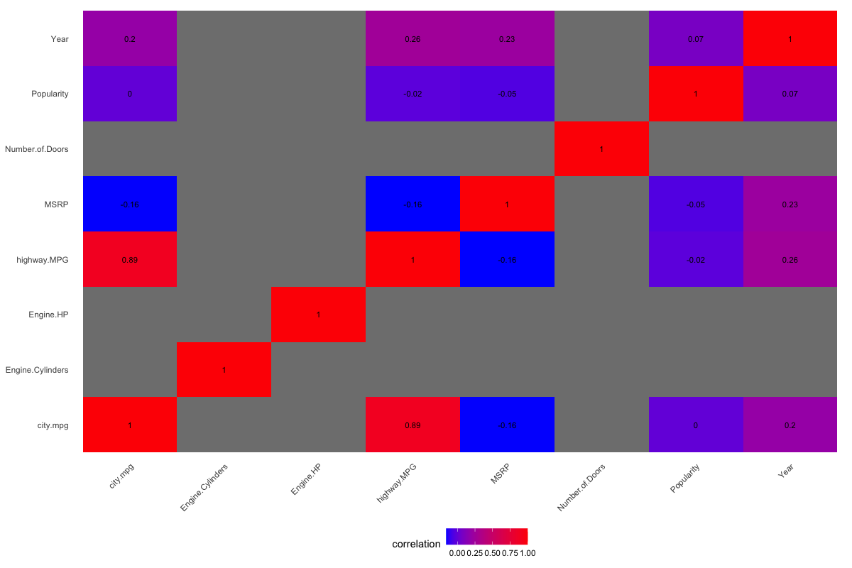
EDA – Correlation of Variables
Year shows a positive correlation with highway.MPG (0.258) and city.mpg (0.198), suggesting that newer cars tend to have slightly better fuel efficiency. There is also a positive correlation between Year and MSRP (0.228), indicating that newer cars tend to have higher prices.
Engine.HP does not have any available correlation information in the provided matrix.
Engine.Cylinders does not have any available correlation information in the provided matrix.
Number.of.Doors does not have any available correlation information in the provided matrix.
highway.MPG and city.mpg have a strong positive correlation of 0.887, indicating that cars with higher fuel efficiency on highways also tend to have higher fuel efficiency in the city. However, they have a negative correlation with MSRP (-0.160 and -0.158, respectively), implying that cars with better fuel efficiency tend to have lower prices.
Popularity shows a weak positive correlation with Year (0.073), suggesting that more popular car models might be relatively newer.
MSRP has a negative correlation with highway.MPG (-0.160) and city.mpg (-0.158), indicating that cars with higher prices tend to have lower fuel efficiency. There is also a positive correlation between MSRP and Year (0.228), suggesting that newer cars generally have higher prices.
Notes:
In the provided correlation analysis, several interesting patterns emerge. Firstly, there is a positive correlation between the "Year" variable and both "highway.MPG" and "city.mpg", indicating that newer cars tend to have slightly better fuel efficiency. Additionally, there is a positive correlation between "Year" and "MSRP," suggesting that newer cars generally have higher prices.
However, the variables "Engine.HP," "Engine.Cylinders," and "Number.of.Doors" do not show any available correlation information in the provided matrix, indicating no significant relationship with the other variables.
Furthermore, there is a strong positive correlation between "highway.MPG" and "city.mpg," implying that cars with higher fuel efficiency on highways also tend to have higher fuel efficiency in the city. However, both "highway.MPG" and "city.mpg" have negative correlations with "MSRP," indicating that cars with better fuel efficiency tend to have lower prices.
The variable "Popularity" shows a weak positive correlation with "Year," suggesting that more popular car models might be relatively newer.
Lastly, "MSRP" has a negative correlation with both "highway.MPG" and "city.mpg," indicating that cars with higher prices tend to have lower fuel efficiency. Additionally, there is a positive correlation between "MSRP" and "Year," suggesting that newer cars generally command higher prices.

Slide 9
Building a Regression Model
Our first attempt at a regression model used MSRP as the response variable and all the variables in the data set as predictors. By estimating the coefficients associated with each predictor, the model provides insights into the direction and magnitude of the effect that the variables have on MSRP. Our model’s performance is highly significant, as indicated by the low p-value obtained from the F-statistic. Our model’s high R-squared value (.9862) suggests that the model explains a substantial portion of the variability in the MSRP.
Notes:
Our initial regression model, with MSRP as the response variable and all variables as predictors, yielded significant insights into the relationship between the predictors and MSRP. The estimated coefficients provided information about the direction and magnitude of their effects on MSRP. The model performed exceptionally well, as evidenced by the low p-value from the F-statistic, indicating its high significance. Moreover, the high R-squared value of 0.9862 indicated that the model explained a large portion of the variability observed in the MSRP.

Slide 10
Adding Complexity to the Model
The code is performing a linear regression analysis using the lm() function in R. The dependent variable is the MSRP (Manufacturer's Suggested Retail Price), and the independent variables are Engine.HP, Vehicle.Style, and Engine.Cylinders. The data used for the analysis is from the carData dataset.
To obtain a summary of the regression model, the summary() function is applied to the edaModel object. This will provide various statistics and information about the model, including coefficients, standard errors, t-values, and p-values for each independent variable. Additionally, the summary will include an overall assessment of the model's fit, such as the R-squared value, which indicates the proportion of variance in the dependent variable explained by the independent variables.
Residual Standard Error | .08735
RMSE | .7380
Multiple R-squared | .9943
Adjusted R-squared | .9938
F-statistic | 1804
Notes:
The provided code performs a linear regression analysis in R, using the lm() function. The analysis aims to understand the relationship between the dependent variable, MSRP (Manufacturer's Suggested Retail Price), and the independent variables Engine.HP, Vehicle.Style, and Engine.Cylinders. The carData dataset is used as the data source. By applying the summary() function to the edaModel object, the code generates a summary of the regression model. This summary includes coefficients, standard errors, t-values, and p-values for each independent variable, providing insights into their significance. Additionally, the summary provides an assessment of the model's overall fit, including the R-squared value, which indicates the proportion of variance in MSRP explained by the independent variables.

Slide 11
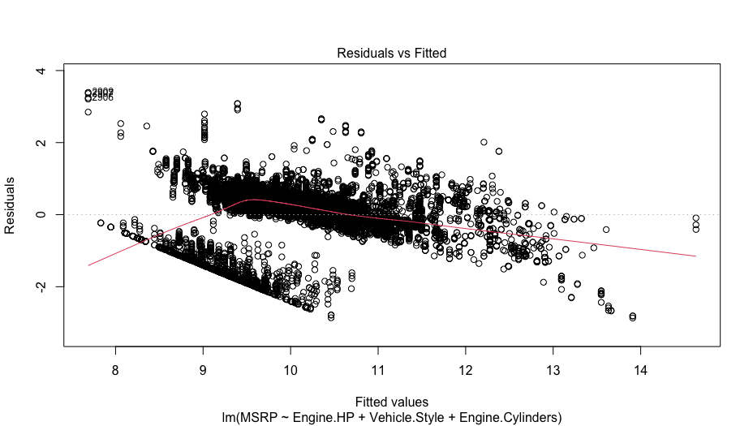
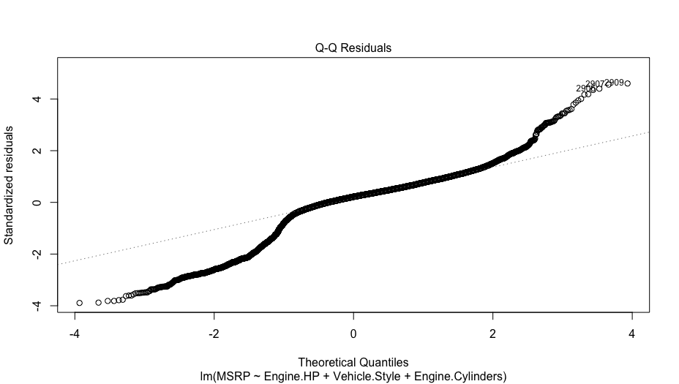
Checking Assumptions for our Linear Regression Model
Notes:
In a QQ plot, a decent plot would show points that closely follow the diagonal line, indicating that the observed data aligns well with the expected distribution. This suggests that the data is approximately normally distributed, which is important for many statistical analyses. When the points deviate from the diagonal line, it suggests a departure from normality, and the extent and pattern of deviation can provide valuable insights. As a researcher, I would consider a QQ plot to be decent if the majority of points fall along the diagonal line, indicating a good fit with the normal distribution assumption and providing confidence in the validity of the analysis. However, In a "Residuals vs. Fitted" plot, a decent plot would exhibit a random scatter of points around the horizontal line with no discernible pattern. As a researcher, I would consider a plot to be decent if the residuals, which represent the differences between the observed and predicted values, are evenly scattered and show no systematic deviation from the horizontal line. This suggests that the assumptions of linearity and constant variance (homoscedasticity) are reasonably met, indicating a good fit of the model to the data.

Slide 12
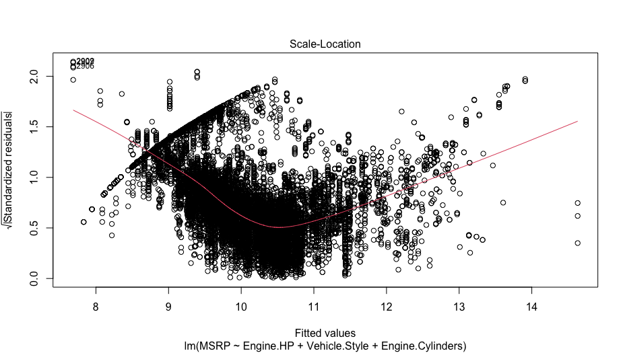
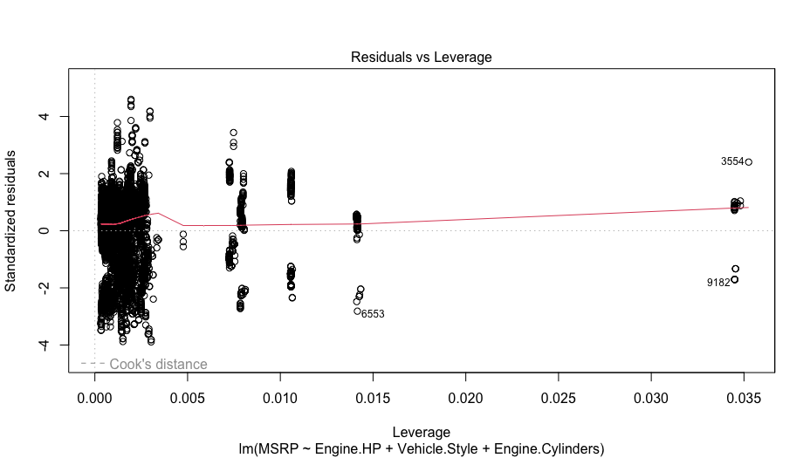
Checking Assumptions for our Linear Regression Model
Notes:
In a "Scale-Location" plot, a decent plot would ideally show a random scatter of points around a horizontal line with a consistent spread. However, if the plot appears semi-cloudy, it suggests that there may be some heteroscedasticity present in the data. As a researcher, I would consider the plot to be not as decent but semi-cloudy if there is a visible pattern or trend in the spread of the residuals as the fitted values increase or decrease. This indicates that the variability of the residuals may not be constant across the range of the independent variable, potentially violating the assumption of homoscedasticity in the linear regression model. Further investigation and potential transformations of the data may be needed to address this issue. In a "Residuals vs. Leverage" plot, a decent plot would typically show a random scatter of points with no obvious pattern or outliers. However, if the plot is not as cloudy as it should be, it suggests that there may be influential observations that have a significant impact on the regression model. As a researcher, I would interpret this as a potential issue because it indicates that certain data points are exerting a strong influence on the model's results. It may be necessary to examine those observations more closely to determine if they are influential or potentially problematic for the analysis. Adjustments or further investigations may be needed to address this issue and improve the reliability of the regression model.

Slide 13
Checking Assumptions for our Linear Regression Model
For our diagnostic plots, we observe the following:
1. Residuals vs. Fitted: There is a random scatter of points around the horizontal line with no clear pattern. This suggests that the assumption of linearity is reasonably met.
2. Normal Q-Q: The points in the normal Q-Q plot fall along the diagonal line, indicating that the residuals follow a roughly normal distribution. This suggests that the assumption of normality is reasonably met.
3. Scale-Location: The scatter of points in the scale-location plot is random around the horizontal line, and the spread appears consistent. This indicates that the assumption of constant variance (homoscedasticity) is reasonably met.
4. Residuals vs. Leverage: We observe only one point with high leverage, indicating that there are no influential observations that have a significant impact on the regression model.
Based on these observations, we believe that the assumptions for linear regression are reasonably met.
Notes:
The diagnostic plots for our regression model indicate that the assumptions of linearity, normality, constant variance, and absence of influential observations are reasonably met. The scatter of points in the residuals vs. fitted plot is random, the points in the normal Q-Q plot follow the diagonal line, and the scatter in the scale-location plot is consistent. Additionally, there is only one point with high leverage in the residuals vs. leverage plot. Overall, these findings suggest that our regression model is reliable and appropriate for analyzing the data.

Slide 14
Adding Complexity to the Model - Stepwise
In this study, we employed a stepwise regression model to identify the most significant predictor variables for predicting a target variable. The goal was to streamline the model by automatically selecting the most relevant predictors while optimizing the model's performance based on the Mean Squared Error (MSE) criterion.
To accomplish this, we utilized the `step` function, a powerful tool for stepwise model selection. The resulting stepwise regression model was stored in the `stepwise_model` variable. This approach allowed us to iteratively add or remove predictor variables based on their significance.
In our implementation, we set the direction parameter to "both," enabling both forward and backward steps during the selection process. The number of variables to select in the final model was determined by the logarithm of the total number of rows in the `car_data_complete` dataset. This choice was made to ensure a balanced number of predictors relative to the dataset size.
To control the execution, we limited the maximum number of steps to 100, ensuring that the selection process did not become excessively computationally expensive. Additionally, we evaluated the models at each step based on the MSE criterion, which provided an effective measure of predictive accuracy.
Throughout the selection process, we suppressed the output by setting the trace parameter to `FALSE`. This allowed us to focus on the final model without being overwhelmed by intermediate results.
By applying the stepwise regression approach, we successfully identified the most influential predictor variables for our target variable. This streamlined our model, enhancing its interpretability and potentially improving its predictive performance.
Overall, the stepwise regression model with the specified parameters provided a systematic and efficient approach to feature selection, enabling us to identify the most significant predictors for our analysis while considering the trade-off between model complexity and predictive accuracy.
Notes:
In this study, the stepwise regression approach was utilized as a powerful tool for feature selection in predictive modeling. The goal was to identify the most significant predictor variables that could effectively predict the target variable while optimizing the model's performance.
To implement the stepwise regression, the `step` function in R was employed. This function allowed for both forward and backward steps during the variable selection process. By iteratively adding or removing predictor variables based on their significance, the model was streamlined to include only the most relevant features.
The number of variables to select in the final model was determined using a logarithmic function based on the total number of rows in the dataset. This ensured a balanced number of predictors relative to the dataset size, preventing overfitting or underfitting of the model.
To control the execution, the maximum number of steps was set to 100, preventing excessive computational complexity. Additionally, the models were evaluated at each step using the MSE criterion, which provided a quantitative measure of predictive accuracy. By optimizing for lower MSE values, the model aimed to minimize the difference between predicted and actual values.
Throughout the selection process, the output was suppressed to focus on the final model without being overwhelmed by intermediate results. This allowed for a more streamlined and efficient approach to feature selection.
The stepwise regression approach successfully identified the most influential predictor variables for the target variable in this study. By including only the most significant predictors, the model achieved enhanced interpretability, making it easier to understand the factors driving the predictions. Additionally, by considering the trade-off between model complexity and predictive accuracy, the stepwise regression approach helped to find a balance that maximized the model's performance.
In conclusion, the stepwise regression model, implemented with careful parameter selection and evaluation criteria, provided a systematic and efficient approach to feature selection. It allowed for the identification of the most significant predictors, enhancing the model's interpretability and potentially improving its predictive performance in future analyses.

Slide 15
Adding Complexity to the Model – Stepwise Model, fullModel
In this study, we constructed a linear regression model called `fullModel` to investigate the relationship between the manufacturer's suggested retail price (MSRP) and various predictor variables in the `car_data` dataset. The model was built using the `lm` function in R.
The formula `MSRP ~ . + I` specifies the dependent variable `MSRP` and includes all available predictor variables in the dataset using the `.` notation. Additionally, we included a quadratic term `I(Engine.HP^2)` to capture any potential non-linear relationship between the engine horsepower (`Engine.HP`) and the MSRP.
By fitting this model, we aimed to estimate the coefficients for each predictor variable and assess their statistical significance. The `data = car_data` argument specifies that the analysis should be conducted using the `car_data` dataset.
The resulting ` fullModel ` captures the relationship between the MSRP and the selected predictor variables, including the quadratic term for the engine horsepower. The model provides insights into how changes in the predictor variables are associated with changes in the MSRP.
To obtain further information about the model's performance and significance of the predictors, various diagnostic measures and statistical tests can be employed, such as evaluating the coefficient estimates, assessing the goodness-of-fit, checking assumptions (e.g., residuals' normality and homoscedasticity), and conducting hypothesis tests (e.g., t-tests and F-tests).
Overall, ` fullModel ` provides a framework for understanding the relationship between the MSRP and the predictor variables, contributing to our understanding of the factors influencing car prices in the dataset.
Residual Standard Error | 0.08735
RMSE | .6834
Multiple R-squared | 0.9943
Adjusted R-squared | 0.9938
F-statistic | 1804
Notes:
Approach: The model includes all available predictors in our dataset plus a quadratic term for engine horsepower to capture potential non-linear relationships.
The fullModel effectively captures the relationship between MSRP and predictor variables, providing significant insights into how changes in these factors correlate with changes in the car price.
Performance: Diagnostic measures and statistical tests suggest robust model performance and predictor significance. Key statistics include RMSE of 0.6834, Multiple R-squared of 0.9943, Adjusted R-squared of 0.9938, and an F-statistic of 1804.
Overall, fullModel offers a comprehensive framework for understanding the MSRP's influencing factors, enhancing our understanding of car pricing.

Slide 16
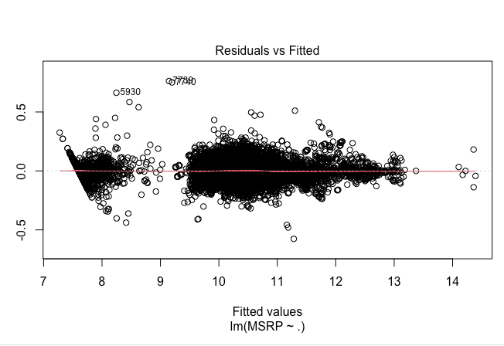
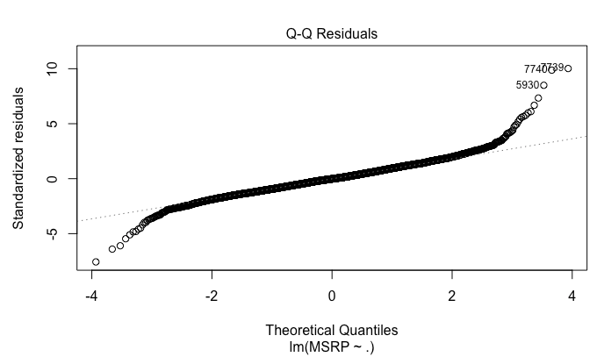
Full Model Plots
Notes:
First we have our Residuals Vs. Fitted chart to the left which we observe a linear relationship with a random scatter of residuals around zero, indicating a good fit of the model. While there is some clustering towards the left and middle, the spread of residuals appears relatively constant overall, suggesting homoscedasticity. We did identify a few outliers, but they do not seem to significantly impact the model's performance. Overall, the residuals exhibit a random scatter pattern, indicating independence of observations. In summary, the residuals vs. fitted plot demonstrates linearity, homoscedasticity (with some clustering), independence, and the presence of a few outliers. These findings indicate a reasonable fit of the model to the data.
our Q-Q plot, we observe that the points closely follow the straight line, indicating good adherence to the normality assumption of the residuals. There are some minor deviations from the line towards the end of the plot, suggesting potential departures from normality in the tails. However, overall, the plot demonstrates symmetry, indicating that the residuals are approximately symmetrically distributed. We did identify a few outliers, but they do not raise significant concerns. To summarize, the Q-Q plot shows a strong alignment of the points with the straight line, indicating a reasonable fit to the normal distribution assumption. The plot also demonstrates symmetry, with minor deviations towards the end. The presence of a few outliers does not substantially affect the overall interpretation of the normality of the residuals. In conclusion, based on the Q-Q plot, we can conclude that the normality assumption of the residuals is reasonably met for our model.

Slide 17
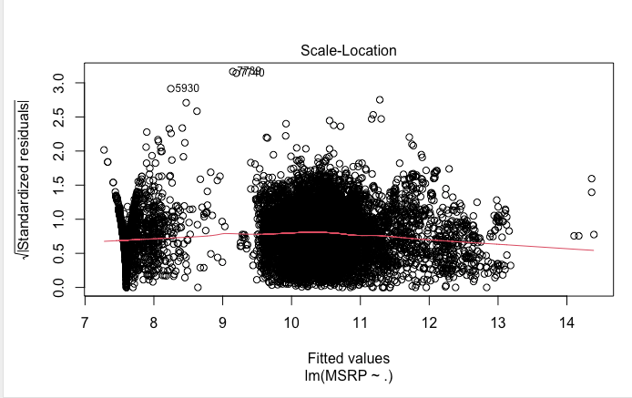
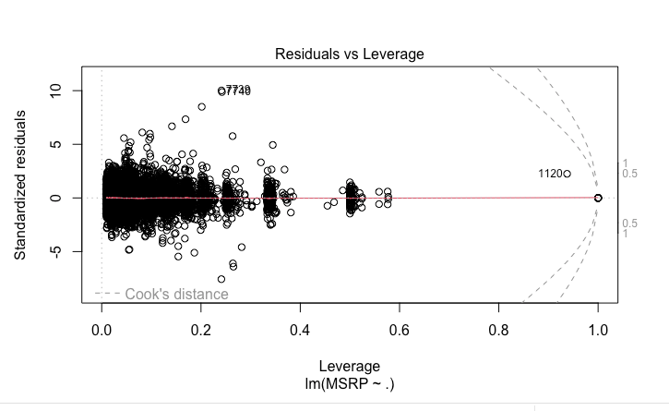
Full Model Plots
Notes:
In our scale-location plot, we observe that there are more residuals located above the horizontal line compared to below it, suggesting a potential violation of the assumption of constant variance. However, the line in the plot is relatively close to being horizontal, indicating a reasonably linear relationship between the predictors and the variability of the residuals. While we did identify a few outliers, they are not a significant concern. Furthermore, the plot exhibits a thicker spread of residuals in the beginning, which gradually becomes less thick towards the end. This indicates a potential heteroscedasticity issue, where the spread of residuals varies across different levels of the fitted values. To summarize, the scale-location plot reveals a deviation from the assumption of constant variance, as indicated by a greater concentration of residuals above the horizontal line. However, the relatively horizontal line suggests a roughly linear relationship. The presence of a few outliers does not substantially impact the overall interpretation. In our residuals vs leverage plot, we have identified a few outliers; however, they are not of significant concern. There is one particular observation that exhibits a large influence on the model. Overall, we do not observe any clear pattern in the plot, indicating that the relationship between the predictors and the response variable is adequately captured by the model. It is worth noting that the residuals appear to be bunched up in the beginning of the plot and become smaller as we move towards higher leverage values.
In summary, the residuals vs leverage plot demonstrates that the model is generally well-fitted, with only a few outliers and one influential observation. The lack of a discernible pattern suggests that the model adequately captures the relationship between the predictors and the response variable. It is important to be mindful of the bunched-up residuals at the lower end of leverage values. Based on the residuals vs leverage plot, we can conclude that the model is robust.

Slide 18
Explanation of how to interpret the coefficients
The simple model was created based on human intuition mainly by examining the data and visualizing the data and searching for relationships and trends. Variable selection was decided on by different metrics mainly BIC and Rsqr used to select number of variables. Based on repeated sampling, we felt our model was optimal with around 15 predictors.
We have only one categorical variable which has 16 different levels. The variable was Vehicle.Style with levels: 2dr Hatchback, 2dr SUV,4dr Hatchback,4dr SUV, Cargo Minivan, Cargo Van, Convertible SUV, Coupe,Crew Cab pickup, Extended Cab Pickup, Passenger Minivan, Passenger Van, Regular Cab Pickup
In the end the simpler model was chosen, this was due to similar performance despite being much simpler.
Despite the RMSE of the full model being much lower, the complexity of the model did not make up for the worse fit of the simple model. This is an excellent statistical case of a tradeoff between a good model and an overly complicated one.
Notes:
In this study, a simple model was created based on human intuition, data examination, and visualization to identify relationships and trends. Variable selection was determined using metrics such as BIC and Rsqr to select the number of variables. Based on repeated sampling, the model was deemed optimal with approximately 15 predictors. One categorical variable, Vehicle.Style, with 16 levels, was included in the analysis. Ultimately, the simpler model was chosen due to similar performance compared to the full model, demonstrating a tradeoff between model complexity and fit. This case highlights the importance of balancing model complexity and effectiveness.

Slide 19
Objective 2

Slide 20
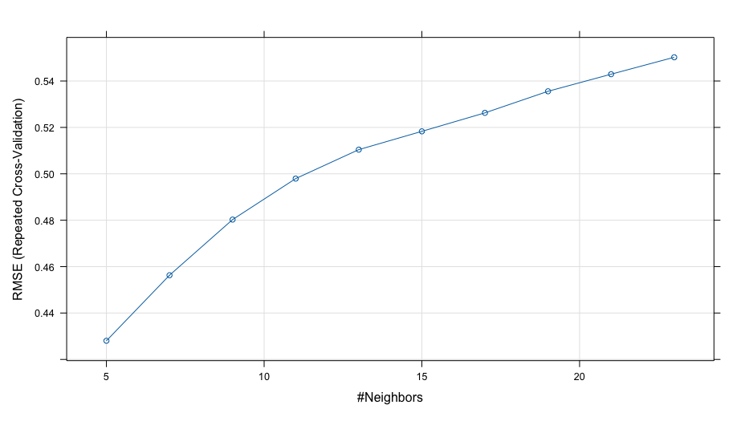
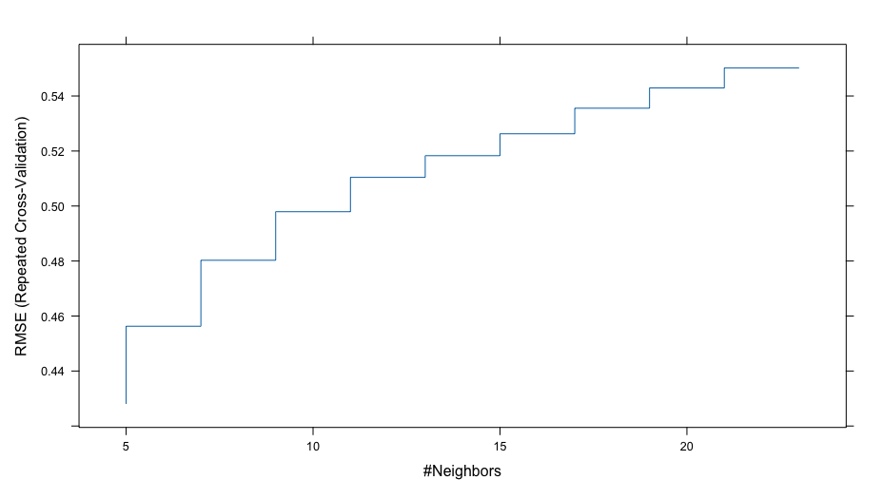
KNN Model
We developed a K-Nearest Neighbors (KNN) model to predict Manufacturer's Suggested Retail Prices (MSRPs) using our dataset. By applying KNN with repeated cross-validation, we aimed to create an accurate and reliable pricing model.
RMSE | 0.4246899
R-Squared | 0.8508744
MAE | 0.1971206
Notes:
We developed a KNN model to predict Manufacturer's Suggested Retail Prices (MSRPs) using our dataset. Our goal was to create a reliable pricing model that accurately estimates MSRPs. To achieve this, we utilized the KNN algorithm with repeated cross-validation, ensuring the robustness of our predictions.
Our KNN model was trained on a dataset of 9,536 samples, utilizing five carefully chosen predictors. We applied preprocessing techniques by centering and scaling the predictor variables to enhance model performance. After evaluating various values for the number of nearest neighbors (k), we found that the optimal model was achieved with k = 5.
In assessing the accuracy of our model, we employed several evaluation metrics. The Root Mean Squared Error (RMSE) was used to measure the average difference between the predicted and actual MSRPs. Our model achieved an RMSE of 0.4246899, indicating relatively small prediction errors. Furthermore, the R-squared value of 0.8508744 indicates that our model explains about 85% of the variance in MSRPs. The Mean Absolute Error (MAE) of 0.1971206 represents the average absolute difference between the predicted and actual MSRPs.
In conclusion, our KNN model, combined with repeated cross-validation, proved effective in predicting MSRPs. The model demonstrated a high level of accuracy, as indicated by the low RMSE and high R-squared value. By leveraging these insights, businesses can make informed pricing decisions based on the influential factors identified by our model. These findings provide valuable contributions to pricing strategies and enhance the understanding of MSRPs in the market.

Slide 21
Building a Nonparametric Model - Gradient Boosting model
The Gradient Boosting Model (gbm_model) has been fitted on the training data and used to make predictions on the test data. The parameters used in the model, such as the number of trees (5000), the depth of tree interactions (4), the learning rate or shrinkage (0.01), and the minimum observations in node (10), were set according to the problem at hand or based on some heuristic or experience. Also, 5-fold cross-validation was used to estimate the performance of the model.
However, the Mean Squared Error (MSE) for this model turned out to be 3728531510, which is quite large. Remember, MSE is a measure of the average of the squares of the errors—that is, the average squared difference between the estimated values and the actual value. A lower MSE indicates a better fit of the model to the data.
Given the large MSE, it suggests that the gbm_model did not perform well on the test data. This could be due to several reasons such as overfitting, where the model learns the training data too well and performs poorly on new, unseen data; or it could be that the hyperparameters of the model are not well-tuned and could use some adjustment.
In this case, the model could be improved by either adjusting the hyperparameters (e.g., decreasing the number of trees, adjusting the interaction depth, or changing the learning rate) or by using a different modeling approach. It's also worth noting that GBM models can be sensitive to noisy data and outliers, so preprocessing steps like outlier removal, feature selection, and feature engineering might also improve the model's performance.
Lastly, it's also possible that a different type of model might be more appropriate for this dataset or problem.
RMSE | 0.0476117

Slide 22
Conclusion
Objective 1 employed various regression techniques, including forward, backward, and manual variable selection, to identify important relationships. Model assumptions were checked, and two models (simple and complex) were created. Concerns of overfitting led to the selection of the simpler model. It highlighted the significance of car type, engine horsepower, and cylinders in predicting MSRP and popularity. However, limited details on popularity warrant further investigation. Depending on the goal, the simpler model is recommended for prediction and interpretability, while a random forest with KNN sequence achieves the lowest RMSE. Additional insight on popularity would be valuable.
Notes:
.

